Slide 1
Serial Data Transfer schemes
P.RAJESH M.Tech.,
Asst Professor
CRIT engg college

Slide 2
Data Communications
Data communications refers to the ability of one computer to exchange data with another computer or a peripheral
Physically, the data comm. path may be a short, 5 to 10 feet ribbon cable connecting a microcomputer and parallel printer; or it might be a high speed telecommunications port connecting two computers thousands of miles apart.
Standard data communication interfaces and standards are needed
Centronic’s parallel printer interface
RS-232 defines a serial communications standard

Slide 3
Serial Data Transfer schemes
Serial Data communication:-
Data within micro computer is transferred in a parallel as it is a fastest way to transfer for data transfer over a long distances.
How ever parallel data transfer requires many wires.
i.E is data sent long distances source is converted to parallel from to serial form so that it can be sent on a single wire (or) pair of wires.

Slide 4
Serial data received from a distance source is converted to parallel form so that it can easily be transferred on micro computer buses.
Classification of serial Data transfer :
1 .simplex
2. half duplex
3. full duplex

Slide 5
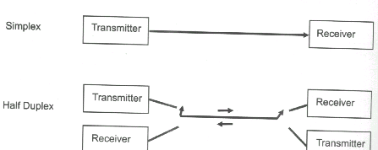
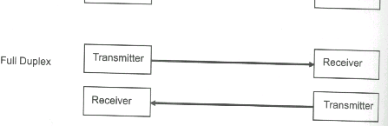
Types of Transmission

Slide 6
Methods of serial data transmission
2 types
A) Synchronous
B) Asynchronous

Slide 7
Synchronous Communications
In this receiver & Transmitter are synchronized , a block of character is transmitted along with the synchronization information.
It is use for high speed transmission
If operating clock frequency transmitter & receiver are equal (Ft = F r) then it is called synchronous serial data transfer.
If there is a difference in frequency there is a error in data transmission.

Slide 8
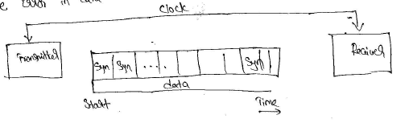

Slide 9
Synchronous Communications
System 1
Transmit data
System 2
Receive data
clk
Signal common

Slide 10
Asynchronous Communications
Eliminates the need for a clock signal between two microprocessor based systems
System 1
Transmit data
System 2
Receive data
Signal common

Slide 11
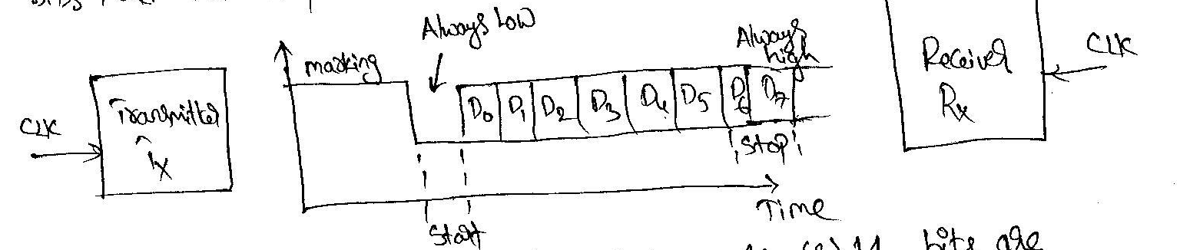
It is a character oriented when number of data is being sent, the signal line is in a constant high (or) marking state.
Transmission begins with one start bit ,followed by a character and one (or) two stop bits ,which is known as framing .
The transmission start bit is always at low (0) and stop bit is always at high (1) .
The transmission of 11 bit for ASCII character in Asynchronous format i.e. one start bit either character bits and two stop bits

Slide 12
The efficiency of this format is low , because 10 (or)11 bits are required to transmit a 7 bit data word such as ASCII character.
The Asynchronous format generally used in low speed transmission.

Slide 13
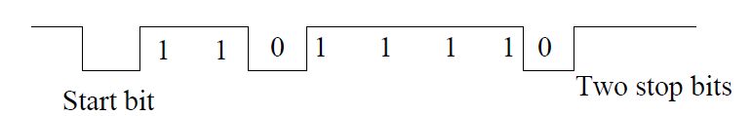
Asynchronous Communications
Data to be transmitted is sent out one character at a time and the receiver end of the communication line synchronization is performed by examining synchronization bits that are included at the beginning and at the end of each character

Slide 14
8251 –USART Universal synchronous Asynchronous Recover & Transmitter
Serial I/O - Programmable Communication Interface

Slide 15
8251 USART
8251 is a PIC (programmable communication interface )chip designed for synchronous & Asynchronous serial data communication packed in 28 pins DIP
The Chip converts the parallel data in to serial system of bits suitable for serial transmission
It is able to receive serial system of bits and convert in to parallel data types to be read by micro processor.

Slide 16
It has built in baud rate generator
It allows full duplex transmission and reception
It provides double buffering of data both in the Tx & Rx
It provides error detection logic which detects party over run and programming errors
It is TTL compatible
It has modem control logic, which supports basic data set control signals

Slide 17
Pin diagram
D2
8251
USART
CONTROLLER
D1
D0
D3
VCC
RXD
RXC
GND
DTR
D4
RTS
D5
DSR
D6
D7
RESET
TXC
CLK
WR
TXD
TXEMPTY
CS
CTS
C/ D
RD
SYNDET/ B0
RXDY
TXRDY

Slide 18
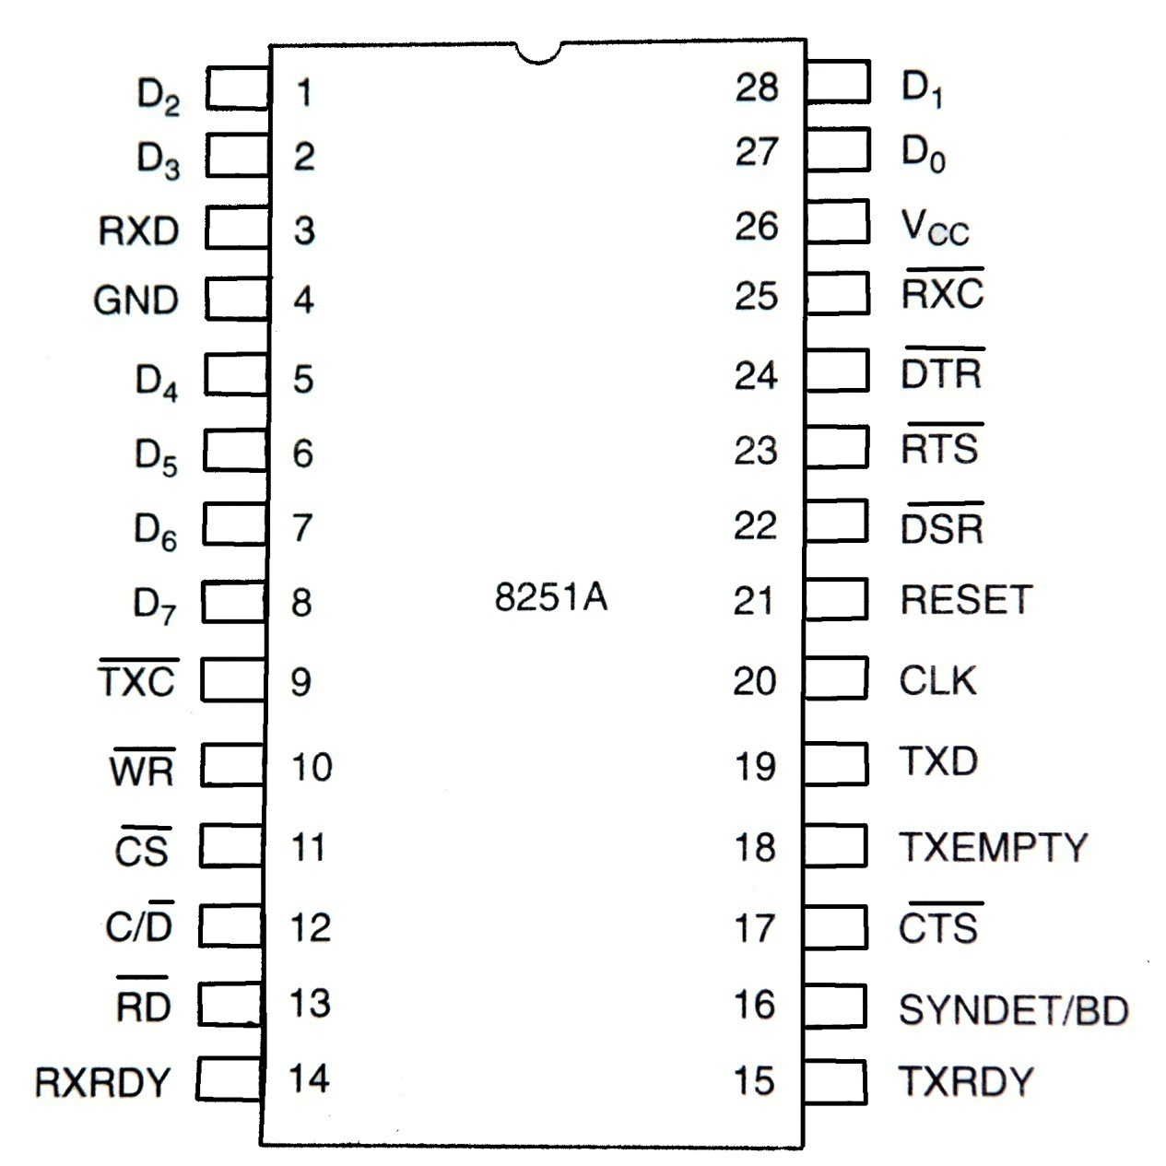
# Pin diagram

Slide 19
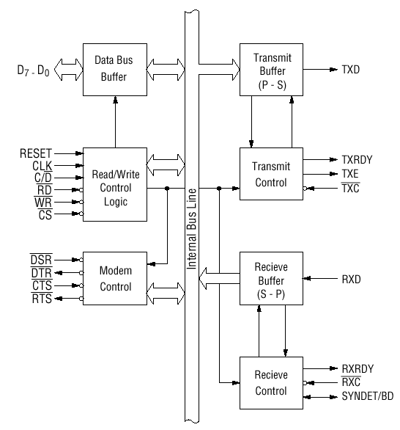
# Block diagram of the 8251 USART

Slide 20
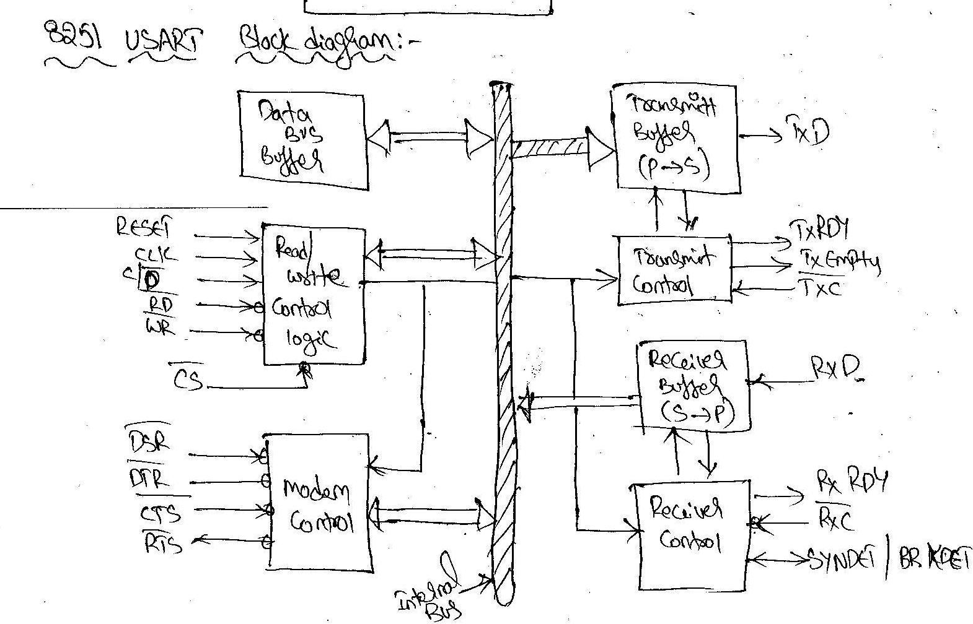

Slide 21
Control Register:-
is a 16-bit reg for a control word of two independent bytes .
First byte is mode instruction
Second byte is command instruction
Status register :-
Checks already status of a pheripheral it is address as input port.
Data buffer reg can be addressed as input port and output port.

Slide 22
Pin diagram description
1) data bus buffer
2)read /write control logic
3)Modem control
4)Transmitter section
5)Receiver section

Slide 23
1 .Data bus buffer :-
D0-D7 : 8-bit data bus used to read or write status, command word or data from or to the 8251A
It indicates internal data bus of 8251 with symbols along with the data ,control word, command word and status information are also transfer through the data bus buffer.
2. Read/write control logic :-
control the operation of the peripheral depending upon operations initialized by cpu
It has 6-input signal ,control logic and 3 buffer receivers ,data registers ,,control register and status register

Slide 24
Input signals
CS – Chip Select : When signal goes low, the 8251A is selected by the MPU for communication.
C/D – Control/Data : When signal is high, the control or status register is addressed; when it is low, data buffer is addressed. (Control register & status register are differentiated by WR and RD signals)
WR : When signal is low, the MPU either writes in the control register or sends output to the data buffer.
RD : When signal goes low, the MPU either reads a status from the status register or accepts data from data buffer.
RESET : A high on this signal reset 8251A & forces it into the idle mode.
CLK : Clock input, usually connected to the system clock for communication with the microprocessor.

Slide 25
CS | C/D | RD | WR | FUNCTION
0 | 1 | 1 | 0 | CPU WRITES INSTRUCTION IN CONTROL REG
0 | 1 | 0 | 1 | CPU READS STATUS FROM STATUS REG
0 | 0 | 1 | 0 | CPU O/P DATA TO THE DATA BUFFER
0 | 0 | 0 | 1 | CPU ACCEPTS DATA FROM DATA BUFFER
1 | X | X | X | USART IS NOT SELECTED

Slide 26
3.Modem control:
It controls modem hand shake signals to coordinate the communication between the modem and the USART.
2 i/p signals and 2o/p signals are associated with modem control section.

Slide 27
3. Modem Control pins
DSR - Data Set Ready : Checks if the Data Set is ready when communicating with a modem.
DTR - Data Terminal Ready : Indicates that the device is ready to accept data when the 8251 is communicating with a modem.
CTS - Clear to Send : If its low, the 8251A is enabled to transmit the serial data provided the enable bit in the command byte is set to ‘1’.
RTS - Request to Send Data : Low signal indicates the modem that the receiver is ready to receive a data byte from the modem.

Slide 28
4. Transmitter section
Accepts parallel data from MPU & converts them into serial data.
Has two registers:
Buffer register : To hold eight bits
Output register : To convert eight bits into a stream of serial bits.
Output Register
Transmitter Buffer
Transmit control

Slide 29
The MPU writes a byte in the buffer register.
Whenever the output register is empty; the contents of buffer register are transferred to output register.
Transmitter section consists of three output & one input signals
TxD - Transmitted Data Output : Output signal to transmit the data to peripherals
TxC - Transmitter Clock Input : Input signal, controls the rate of transmission.
TxRDY - Transmitter Ready : Output signal, indicates the buffer register is empty and the USART is ready to accept the next data byte.
TxE - Transmitter Empty : Output signal to indicate the output register is empty and the USART is ready to accept the next data byte.

Slide 30
5. Receiver Section
Accepts serial data on the RxD pin and converts them to parallel data.
Has two registers :
Receiver input register
Buffer register
Input Register
RxD
Receive Buffer
RxRDY
Receive control
RxC

Slide 31
When RxD goes low, the control logic assumes it is a start bit, waits for half bit time, and samples the line again. If the line is still low, the input register accepts the following data, and loads it into buffer register at the rate determined by the receiver clock.
RxRDY - Receiver Ready Output: Output signal, goes high when the USART has a character in the buffer register & is ready to transfer it to the MPU.
RxD - Receive Data Input : Bits are received serially on this line & converted into a parallel byte in the receiver input register.
RxC - Receiver Clock Input : Clock signal that controls the rate at which bits are received by the USART.
syndet/BD :- sync detect/Break detect : it has 2 users when the device is operating in asynchronous mode this goes high.
If serial data input line RxD stays low for more than 2-characters times. The signal then indicates on intentional break in data transmission (or) a break in signal line .
When programmed for synchronous data transmission this pin will go high.

Slide 32
Initializing of 8251
To initialize 8251 must send a mode word & command word to control register address for the device .
The status word provides the information concerning register status and transmission errors and this word is read from control reg address.
Mode word
Control word
command word

Slide 33
TRANSMISSION
synchronous Mode
RECEIVER
TRANSMISSION
Asynchronous Mode
RECEIVER

Slide 34
Asynchronous Mode
D7 | D6 | D5 | D4 | D3 | D2 | D1 | D0
S2 | S1 | EP | PEN | L2 | L1 | B2 | B1
0 | 0 | INVALID
0 | 1 | 1 BIT
1 | 0 | 1 ½ BIT
1 | 1 | 2 BIT
1 | EVEN PARITY
0 | ODD PARITY
0 | 0 | SYNC MODE
0 | 1 | 1* ASY
1 | 0 | 16*ASY
1 | 1 | 64*ASYN
1 | PARITY ENABLE
0 | DISABLE
0 | 0 | 5 BITS
0 | 1 | 6 BITS
1 | 0 | 7 BITS
1 | 1 | 8 BITS

Slide 35
synchronous Mode
D7 | D6 | D5 | D4 | D3 | D2 | D1 | D0
SCS | ESD | EP | PEN | L2 | L1 | 0 | 0
1 | SINGLE CHAR SYNC
0 | DOUBLE CHAR SYNC
1 | SYNDET IS I/P
0 | SYNDET IS O/P
0 | 0 | 5 BITS
0 | 1 | 6 BITS
1 | 0 | 7 BITS
1 | 1 | 8 BITS
1 | PARITY ENABLE
0 | DISABLE
1 | EVEN PARITY GENERATE & CHECK
0 | ODD PARITY

Slide 36
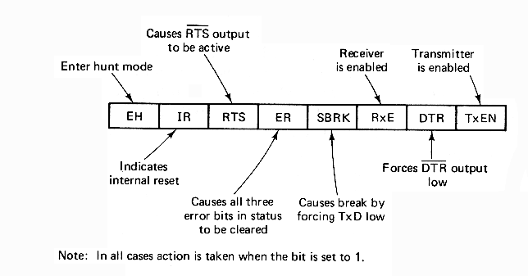
COMMAND WORD

Slide 37
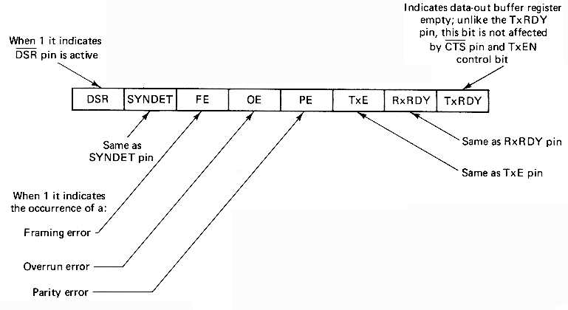
Format of the status register

